Slide 1
Semi-Final Project Presentation: NYC Property Sales
Markus Afonso

Slide 2
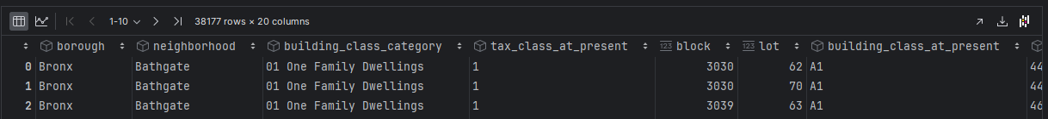
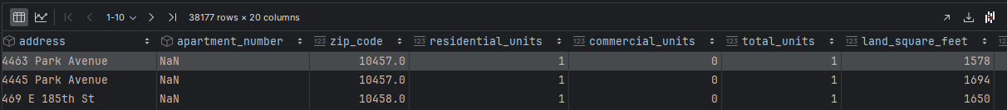
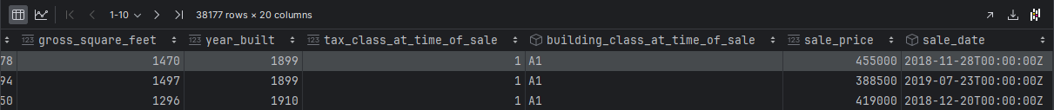
Problem Definition:
Problem Definition: What is the projected sale price of a 2000 sqft home?
Dataset:

Slide 3
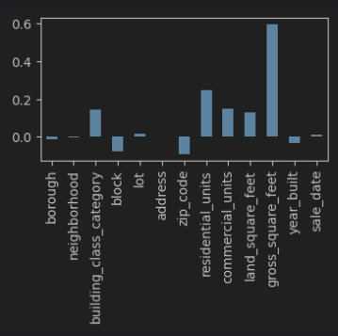
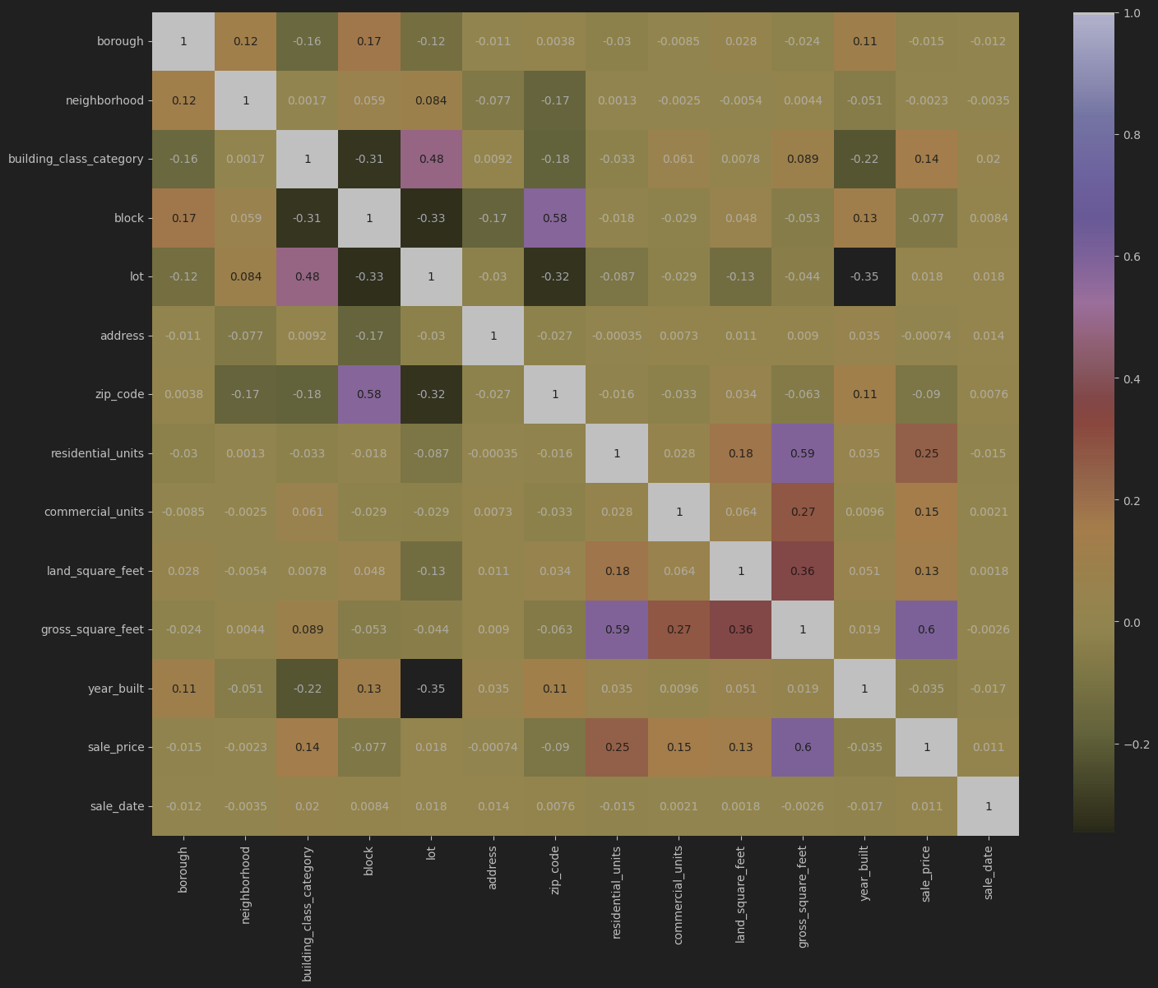
Problem Definition:

Slide 4
Feature Scaling:
gross_square_feet, residential_units, commercial_units, land_square_feet

Slide 5
Data Modeling - Model Selection
Decision Tree
Simple and easy to understand
Random Forest
multiple decision trees to improve accuracy and reduce overfitting
Gradient Boosting Regression (GBR)
Like random forest
Seemed cool

Slide 6
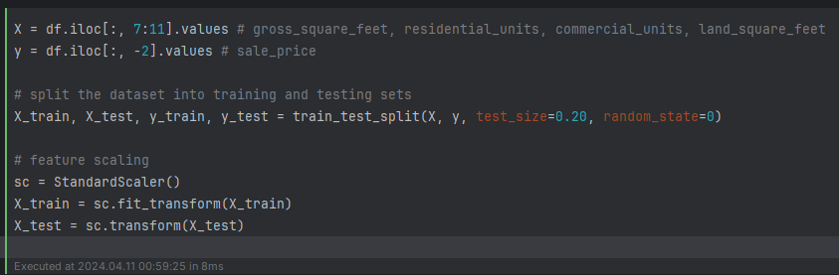
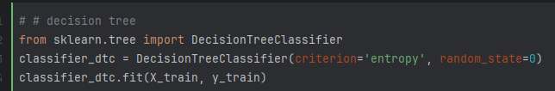
Data Modeling - Implementation

Slide 7
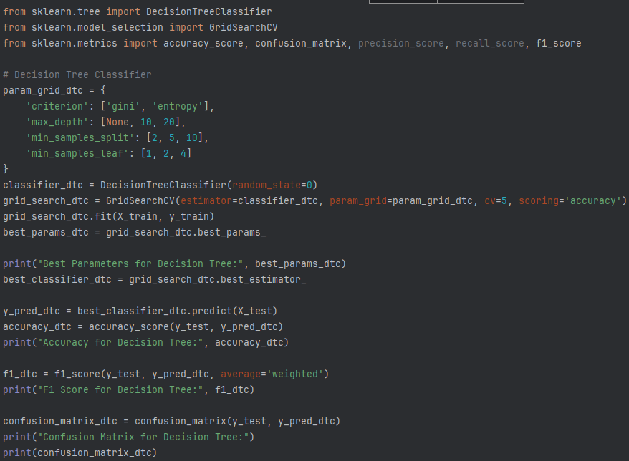
Data Modeling - Hyperparameter Tuning

Slide 8

Evaluation

Slide 9
Conclusion:
data analytics techniques
Clean and transform data
models using statistical techniques
data visualization tools
Evaluate and interpret results
Machine Learning

Slide 10
Thank you

